Slide 1
S-100 Validation Tests sub group
10th VTC Meeting
28th October 2024

Slide 2
Meeting protocol
Meeting participants are kindly requested to note the following meeting protocols;
Please keep your camera and microphone turned “off” if you are not talking or presenting
If you want to make an intervention, please turn your camera and microphone on and, raise your hand to indicate that you wish to speak
Don’t forget to turn your microphone “on” before speaking, and “off” when finished
Please use the “Chat” function to communicate an text information to the meeting
If you have any problems connecting using Firefox or other browser – please try using Chrome.

Slide 3
AGENDA
Status of draft documents
Issues identified while preparing S-158 drafts
Preparation for S-100 WG9 meeting in November
Open issues
Next meeting

Slide 4
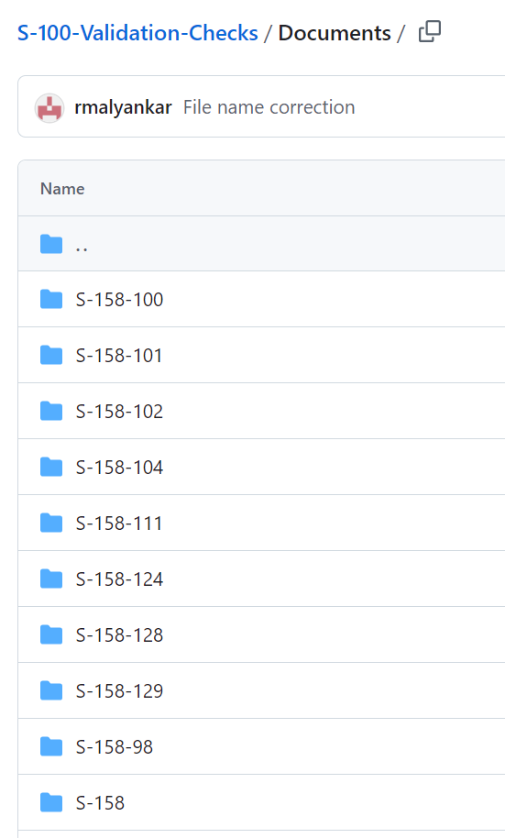
Current status
Following documents are out for review:
S-158:101
S-158:102
S-158:104
S-158:111
S-158:124
S-158:129
Comprises of cover text document and spreadsheet of checks
Received feedback from S-101, S-102 and S-129
Will discuss handover of S-158:1xx to PS teams at S-100 WG9
Once handed over are the responsibility of the PS team
Will require a change management procedure

Slide 5
Current status cont.
Contract has been awarded to Raphael Malyankar to produce the S-100 validation checks & cross product validation, cover documents
Funds for contract supplied by IC-ENC
Draft ready December 2024
Final ready February 2025
Submission to HSSC 17

Slide 6
citations
Long standing issue of how to list multiple clauses in S-158
Circulated 2 options in September around PS owners, implementers and RENCs
Machine readable vs. human readable
Agreed on option 1, using box brackets to separate clause numbers for different documents
Being able to refer to a Clause or a Table
Many of the S-102 checks refer to tables not a text clause
Propose that this is acceptable
Note:
documents must be separated by semicolon+space
Box brackets in clause reference must be separated by semicolon+space
Clause references for the same document must be separated by comma+space
No use of "and" before the last clause reference (or document)
No box brackets if there is only one document cited
Standards document reference | Clause reference
PS; Annex B | [4.3.2.1.1]; [5.1.28, 6.1.2.7]
PS | 4.3.2.1.1
PS; Annex A | [10.1.3]; [2.4.2]
PS; Annex A | [10.1.3]; [2.4.2]
Part 10a | 10a-7.2.4.1, 10a-7.2.4.2.7, 10a-7.2.4.2.8

Slide 7
Language consistency
Can be difficult to identify if checks are duplicated in S-100 and PS validation checks as have been written in a different style.
Likely will need to be a revision of language in the future
Will raise at S-100 WG

Slide 8
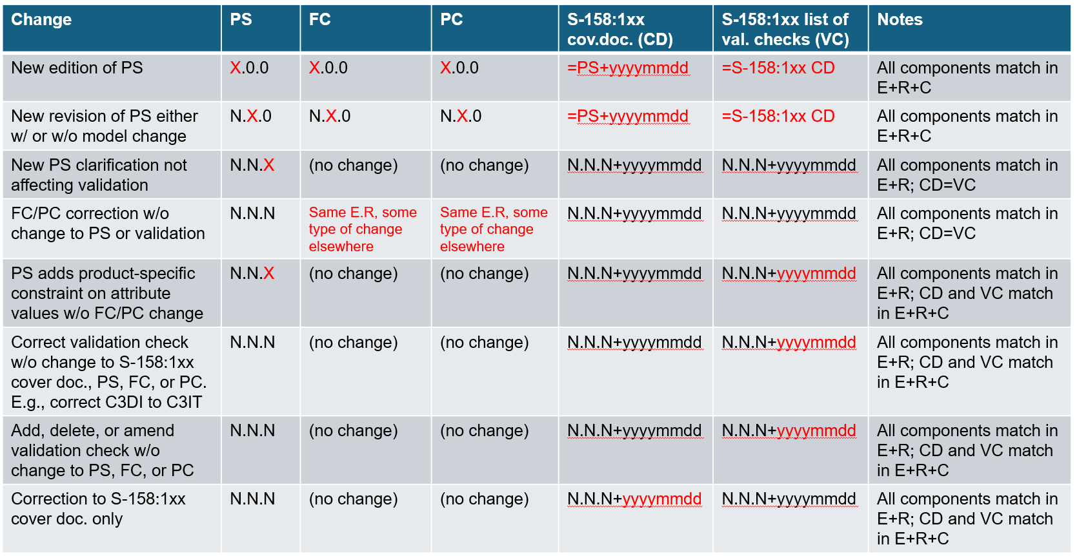
versioning
E= Edition, R= Revision, C=Clarification
CD= cover document, VC= validation checks

Slide 9
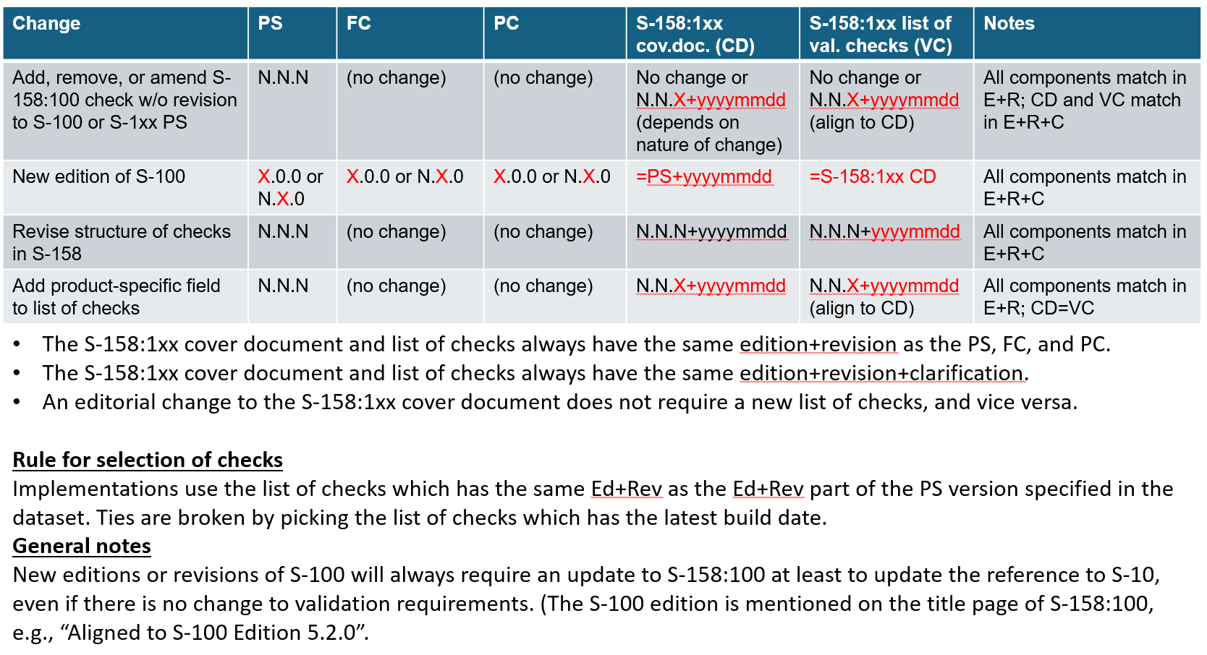
Versioning cont.

Slide 10
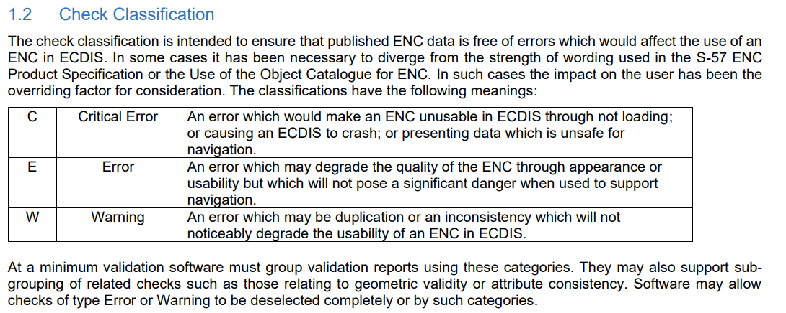
Check classification
Use of current S-58 Classifications – Critical Error, Error & Warning – ENC and ECDIS specific.
Will need rewording for S-100
GitHub Issue open on whether to change Critical Error to just Critical to avoid confusion #52

Slide 11
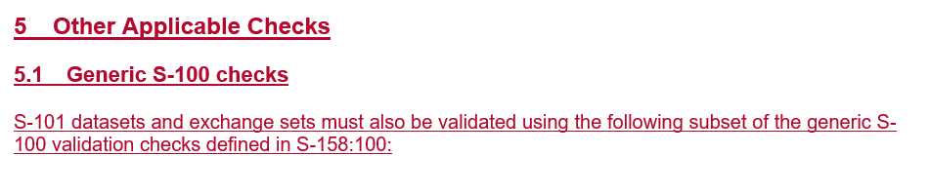
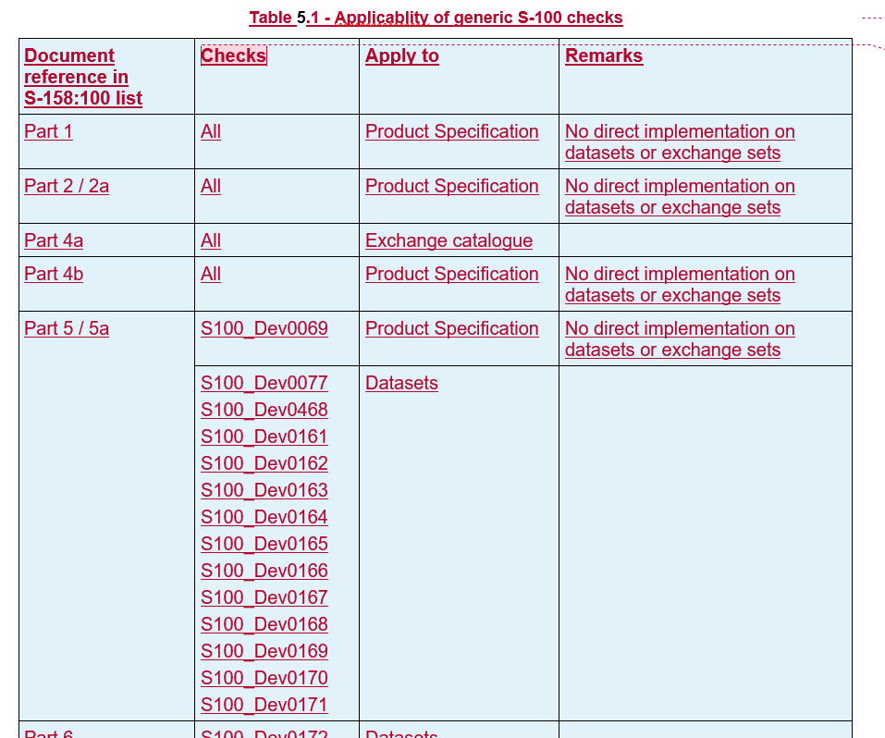
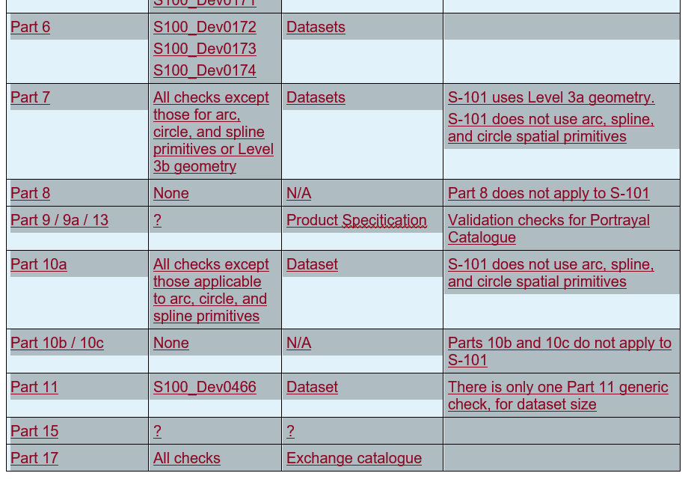
Applicability of generic S-100 checks to PS
Linking which S-100 validation checks or Parts are relevant to different Product Specifications?

Slide 12
Difference between dataset checks and standards checks
The S-100 validation checks contain a mixture of checks for two very different use cases.
Checks for products, which are used by data producers to validate datasets .
Checks to validate standards. These are used by standards organizations, such as the IHO to validate that their standards, i.e. product specifications, feature catalogues, etc. are compliant with S-100. An example is check S100_Dev0009.
These two types of checks have very different user groups.
It is not the responsibility of the data producer to validate components of the standard, e.g., feature catalogues. Once signed, it is assumed that the feature catalogue has been validated and is correct.
Validation software designed to validate datasets should not be required to validate components of the standard. There will be separate software applications for points 1 and 2, since the user groups are very different. As such, it would be a very good idea to somehow mark validation checks related to the verification of a standard.
Proposal: Raise as topic at S-100 WG with potential options
e.g. different document, separate sections in S-158:100 or tag to identify.

Slide 13
Template feedback - DQWG
I would like to provide some recommendations and comments as follow:
1. it is recommended to swap the positions of column “Data Quality Measure” and column “Classification”。
2. There is an ordering in data quality evaluation which is recommended to be followed in the template. When evaluating data quality, the usual ordering is:
a) Logical consistency/Format consistency: The very first to be evaluated is the readability (or interpretability) of the data to decide whether it is possible to decode/read/understand the data or not. Not interpretable data should be reported and ignored in the further evaluation. The result of the format consistency should describe which parts of the data are not readable.
b) Other Logical consistency (concept consistency, domain consistency and topological consistency): Decide if the rules set up for the data set are followed. Parts of the data set not conforming to the rules should be ignored in the further evaluation.
c) Completeness (Commission and omission): The next step in the evaluation is the feature (not attribute or item) existence aspect covered by completeness. To evaluate this, the features in the actual data set and the ground truth data are compared, and commissions and omissions reported.
d) Accuracy (positional, thematic and temporal aspects): The last step in the evaluation covers the accuracy aspect, measuring the deviation between actual and ground truth feature properties. These measurements can be based only on parts of the data set present in both the actual data set and the universe of discourse.
3. A draft guidelines on the data quality evaluation of S-100 products has been developed by DQWG and presented in HSSC16. Noting the link between S-158 and the Data quality evaluation of S-100 products, HSSC invited the DQWG and the S-100WG to discuss the possible development of a guidance on data quality evaluation of S-100 products (Action HSSC16/72). I will try to share the draft guidelines in S-100WG9.
(paper submitted to S-100 WG 9-08.02)
Dev ID | Check ID | Classification | Check Message | Check Description | Check Solution | Standards document reference | Clause reference | Data Quality Measure | Introduced | Modified | Deleted
Separately it has been raised if we retain DQ Measure?

Slide 14
Format of checks and reuse
The Excel format is working for now, but we all recongise this will not work longer term
Suggestions for a new Registry, a database, Metanorma, xml format
Different use cases
The documents cross multiple working groups, will there be an agreed format for all or can it differ
Reuse of validation checks for other product specifications
Inland ENCs and AMLs may want to replicate some of the S-101 checks
Will raise at S-100 WG, proposing to recommend to HSSC that ICE-PT assist

Slide 15
Cross product validation
Restrictions may be needed for WLA
Likely these will need to be handled through validation checks
Refinement will likely be needed
e.g. alignment of display scales, datums across products
Will be discussed at S-100 WG either in S-98 or Validation section, possibly both
Need to establish how we will coordinate across working groups & PTs

Slide 16
Presentation to S-100 WG9
Status of production of validation checks incl. cross product validation
WLA checks
Template and feedback from DQWG & do we retain DQ Measure
Issues encountered e.g. citations, versioning, language
Check classification
Potential need for splitting datasets and standards validation checks
Handover and change process (Managed Impact Study)
Longer term format of validation checks
Issue with Part 6 checks – is anyone using this Part?

Slide 17
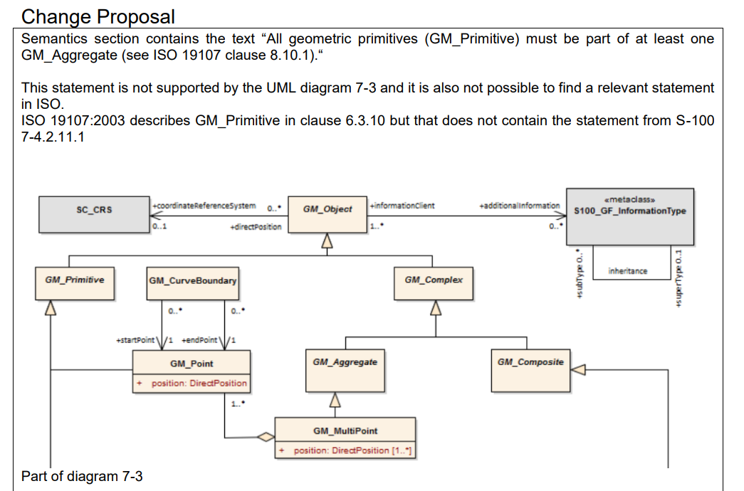
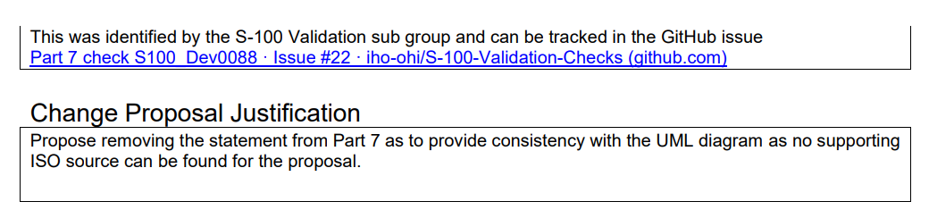
Change proposal submitted
Remove Part 7 statement that all geometric primitives must be part of at least one GM_Aggregate
S100 WG 04-11

Slide 18
ISSues
https://github.com/iho-ohi/S-100-Validation-Checks/issues
30 open, 16 issues related to the 10c checks (been open since February)
10c checks:
Where there is no disagreement I will give two weeks and then I am closing them accepting initial comments from Raphael
Six with disagreement which we can decide on now.
Many of the other issues can be resolved

Slide 19
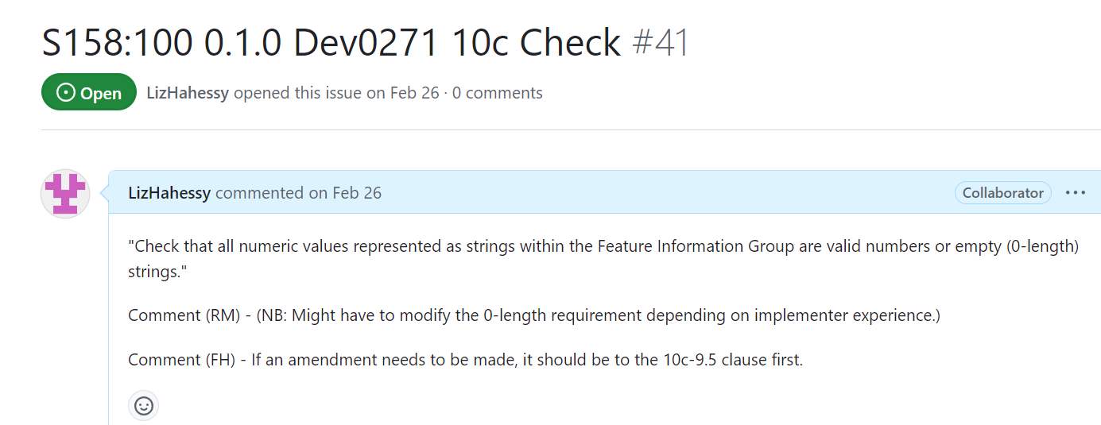
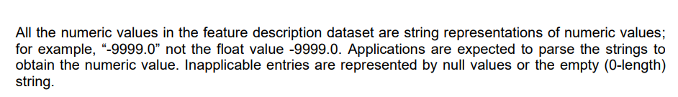
Issue 41
10c – 9.5
Propose leave as is for now

Slide 20
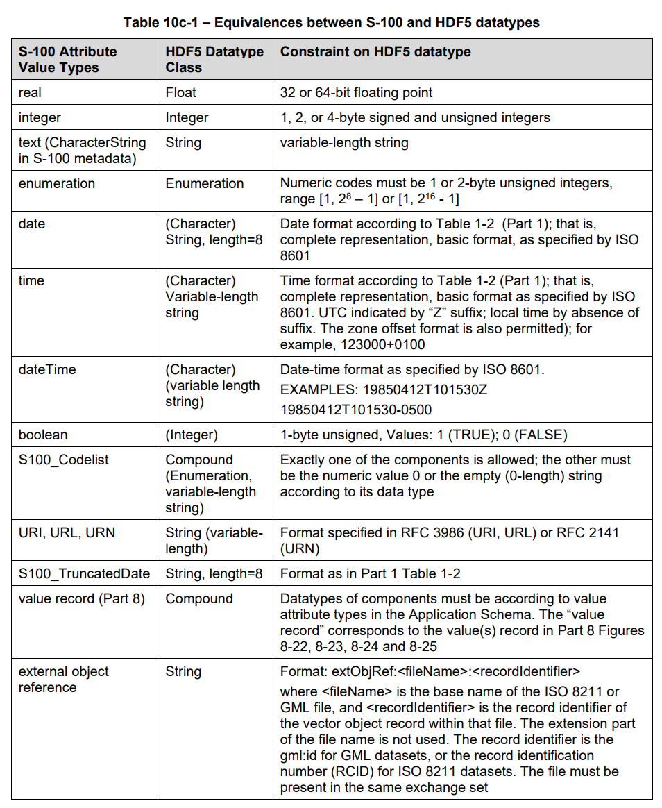
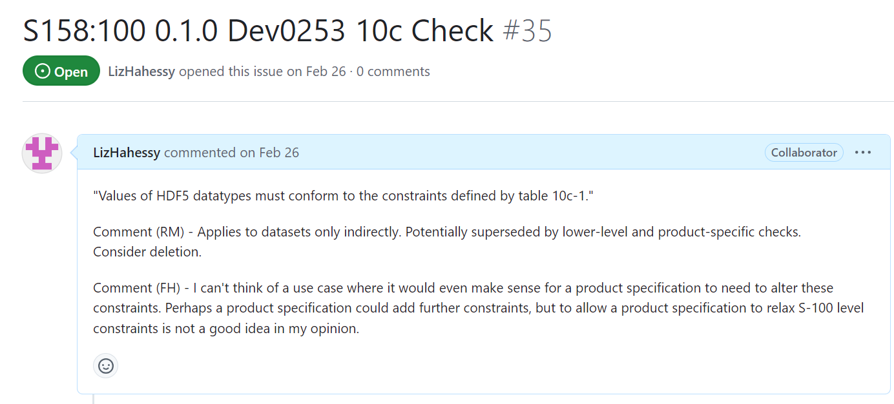
Issue 35
Propose leave as is for now

Slide 21
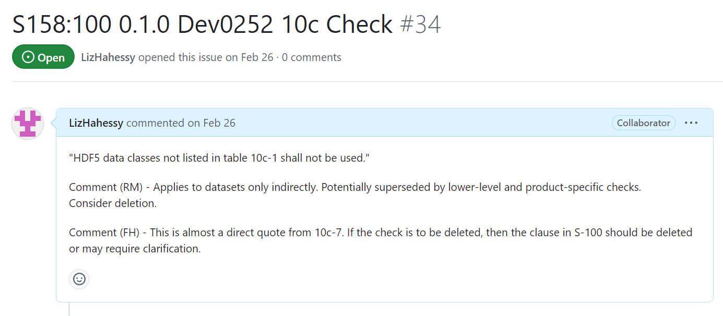
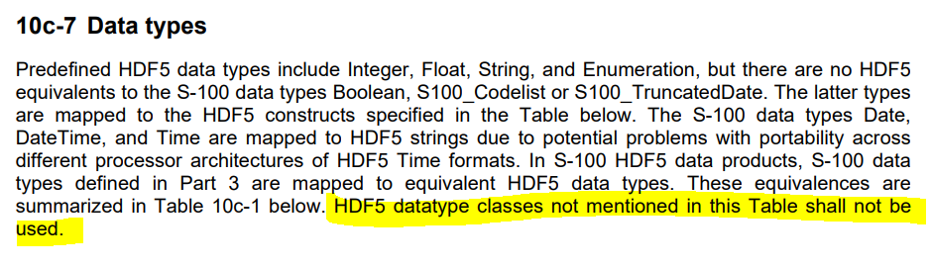
Issue 34
Propose leave as is for now

Slide 22
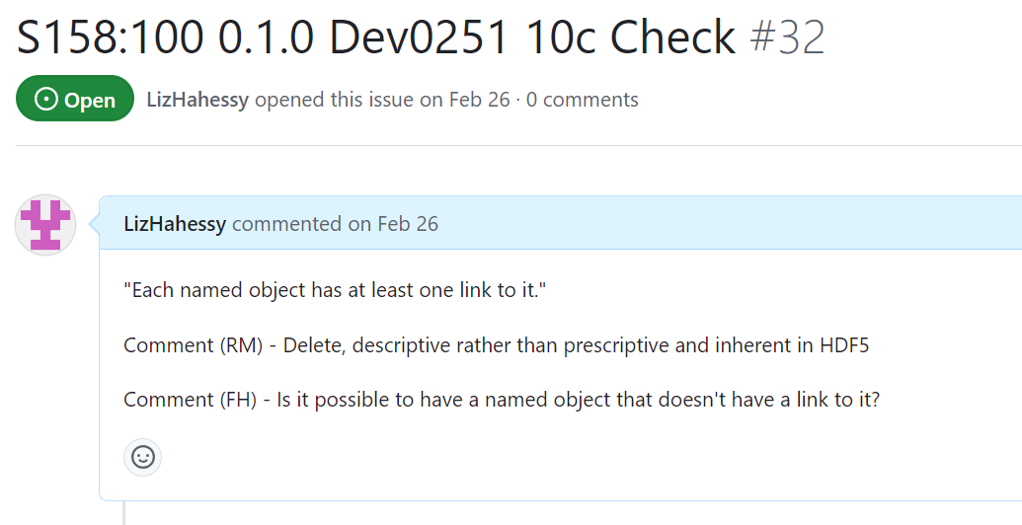
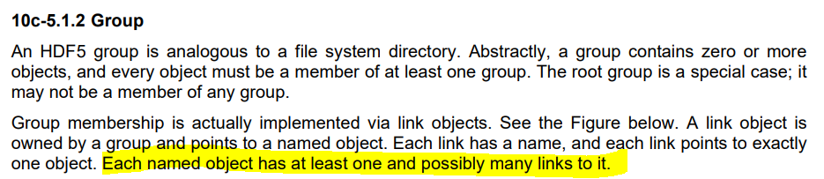
Issue 32
Propose leave as is for now

Slide 23
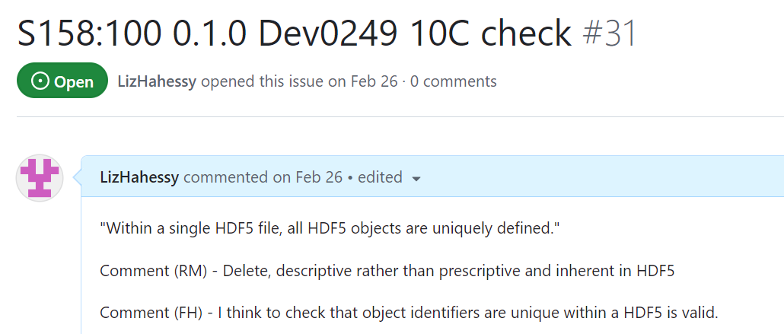
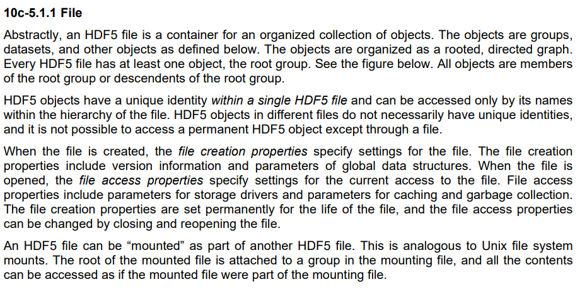
Issue 31
Propose ?

Slide 24
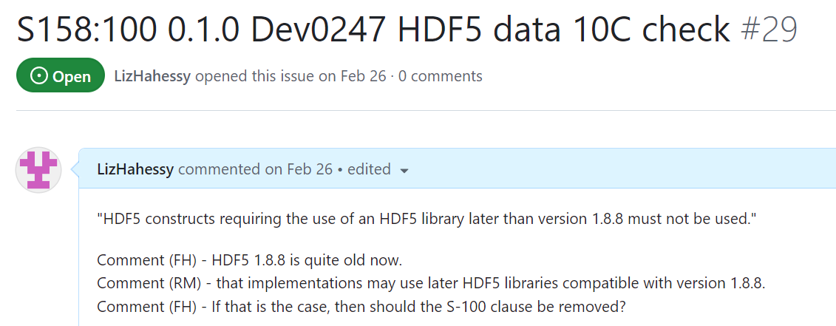
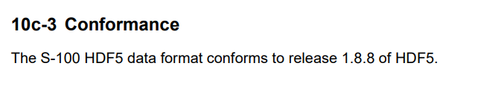
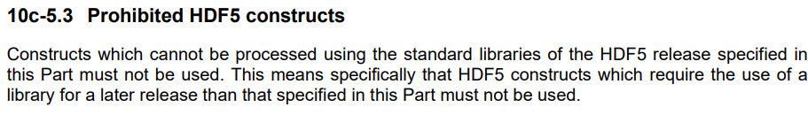
Issue 29
Propose leave as is for now

Slide 25
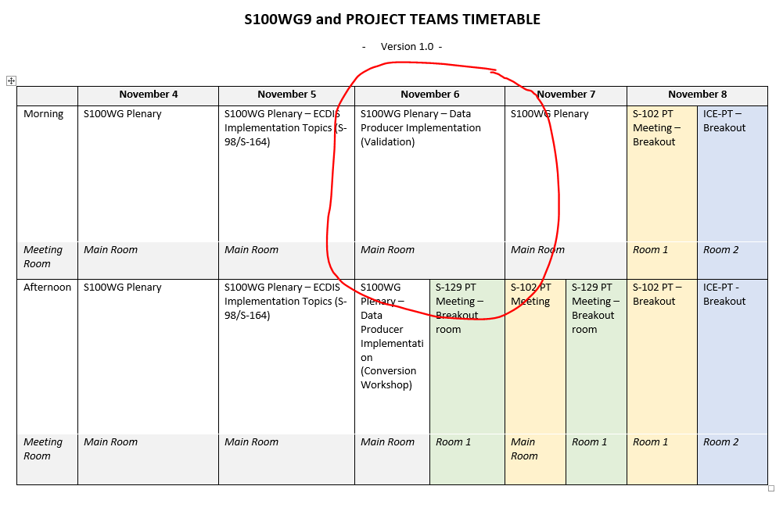
Next steps
Continue producing a set of tests from Parts of S-100 and cross product checks
Coordinate Cross-Product Validation with S-98/S-164 lead, DQWG and S-1xx PS owners
Prepare papers and validation session for S-100 WG9
Start resolving open issues on GitHub

Slide 26
Next meetings
S-100WG9, Genoa, Italy – 04/11/24 – 08/11/24
Suggest next VTC meeting is January

Slide 27
Any Questions?

